Slide 1
Photography skills
Year 2

Slide 2
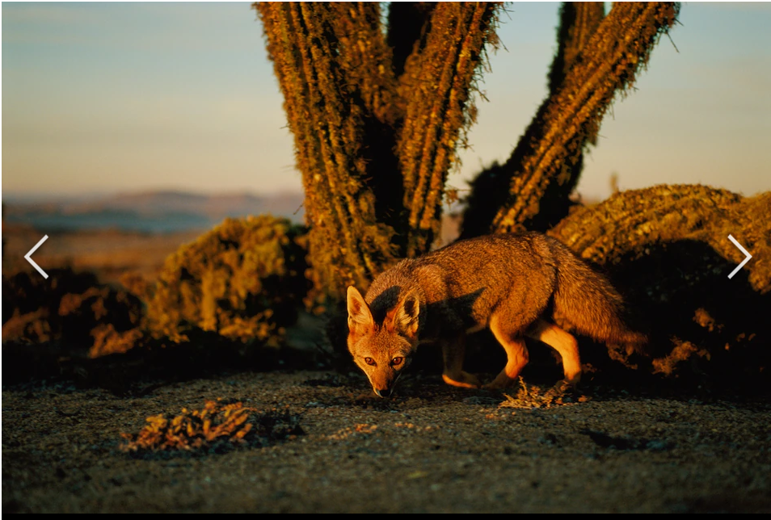
What makes this a good photograph?
Notes:
KWL- grid on the whiteboard. What is the children’s baseline knowledge and technical vocabulary like?

Slide 3
Learning objectives
To be able to hold take photos in different orientations
To be able to use capture subject using rule of 3rds
To be able to take photos in different perspectives

Slide 4
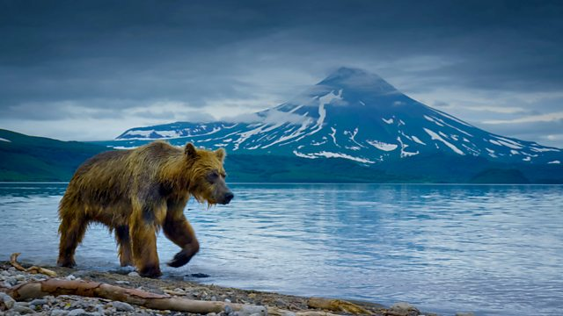
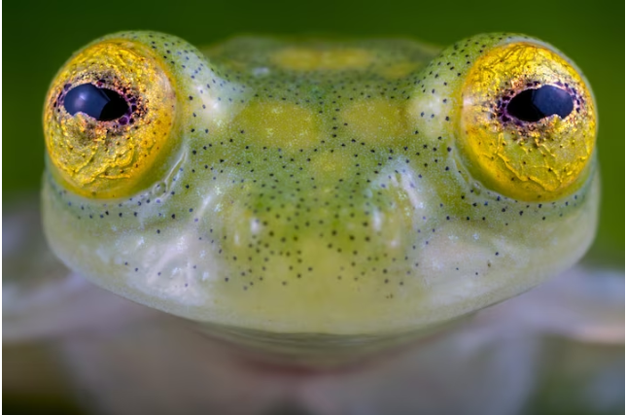
Subject
Position
Notes:
Can they identify the subject and describe its position from the camera and compared to the other

Slide 5
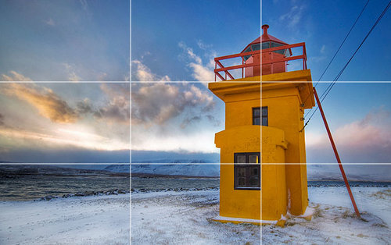
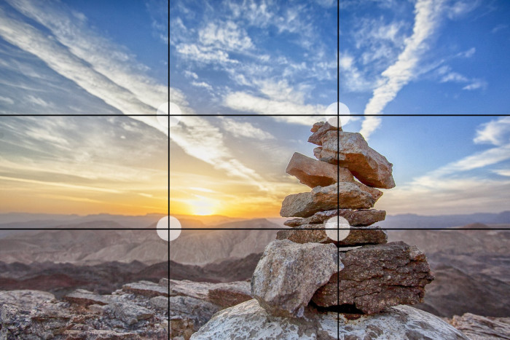
The rule of thirds and using the grid on your camera.
Landscape
Portrait

Slide 6
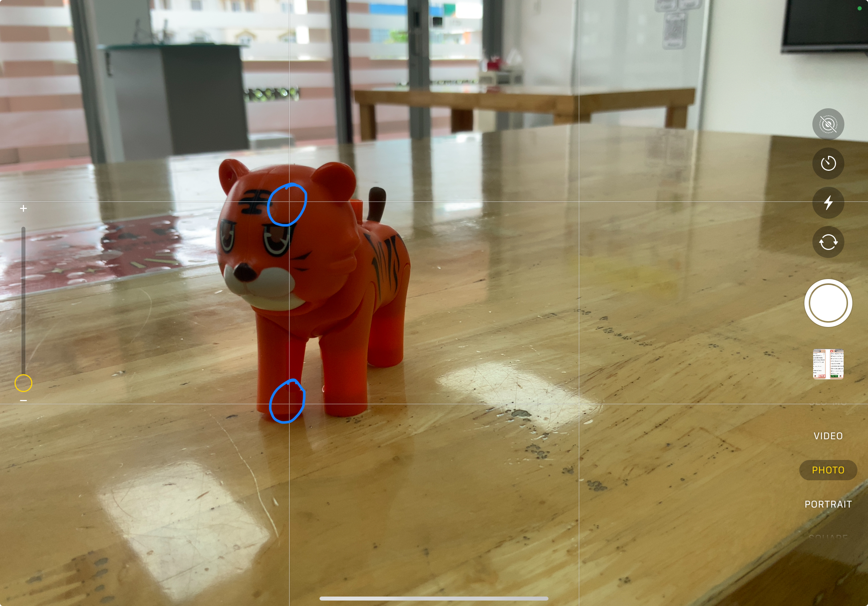
How to take a photo using the grid
Place the subject of your photo over where two lines cross over.
You might have POSITION your camera close to the subject
Don’t be scared to get low to the ground

Slide 7
Today’s challenge:
Working with your friend:
Take 3-4 photos of your toy dinosaur
Take some portrait and landscape
Follow the rule of thirds
Take from low and high perspective
Notes:
Challenge the students for quality. Take many shots and delete the ones they don’t want later. 4 quality photos max

Slide 8

Add 4 photos and videos to Book Creator
Save Book Creator as a video
Share to Seesaw
Notes:
I made a seesaw activity to complete for each style of Photograph instead if you want to use it: https://app.seesaw.me/pages/shared_activity?prompt_id=prompt.d1758574-4ad4-4366-8a04-3b853ea2adfe&share_token=kaOcR2moTaKBjgZ7zDG9SQ

Slide 9
Photography skills
Year 2

Slide 10
What is photography skills is this?

Slide 11
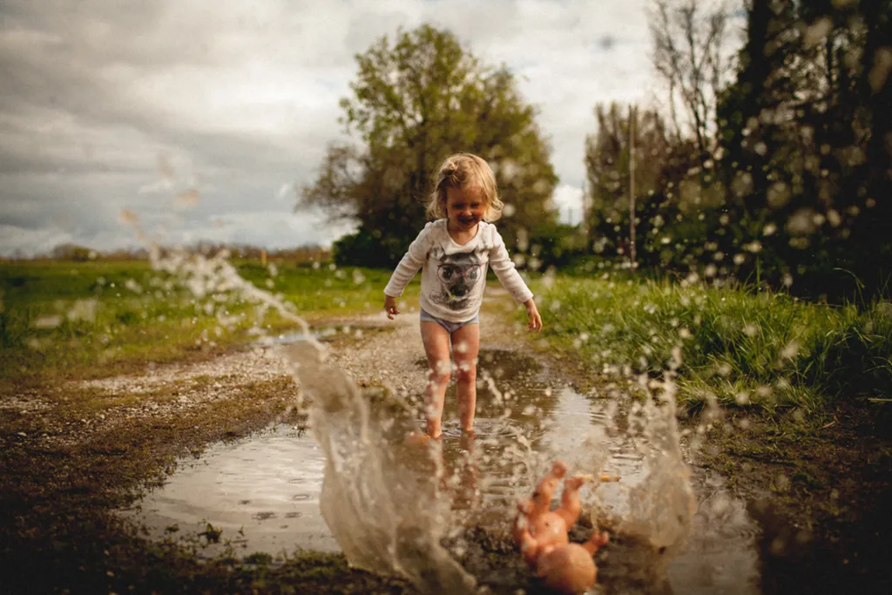
Action photos
How can we show movement in photos?

Slide 12
Learning objectives
To be able to capture movement in a photo
To be able to use burst mode
To be able select and edit best photos

Slide 13
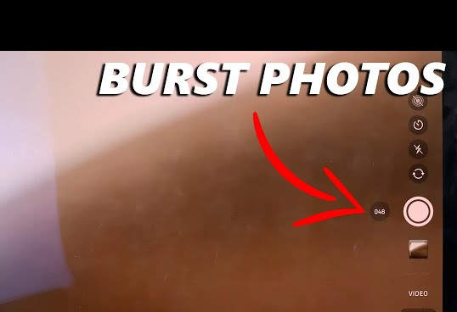
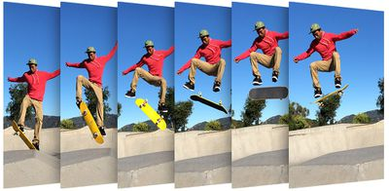
What is an action photo?
How can you take an action photo?
Notes:
Discuss:
How do you know when to take the photo? Show them how to use burst mode
Where should you be?
What should you do before taking the photo? *click on where you would like the camera to focus.
Mention: position, subject

Slide 14
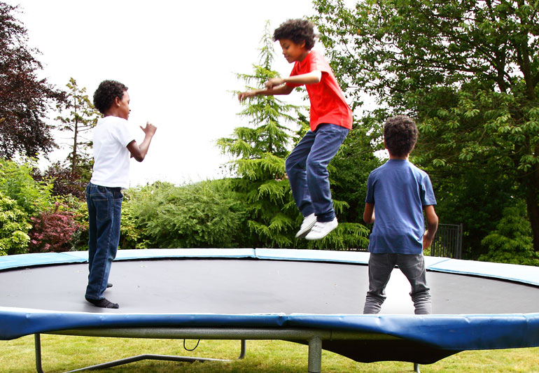
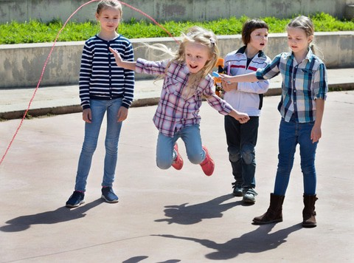
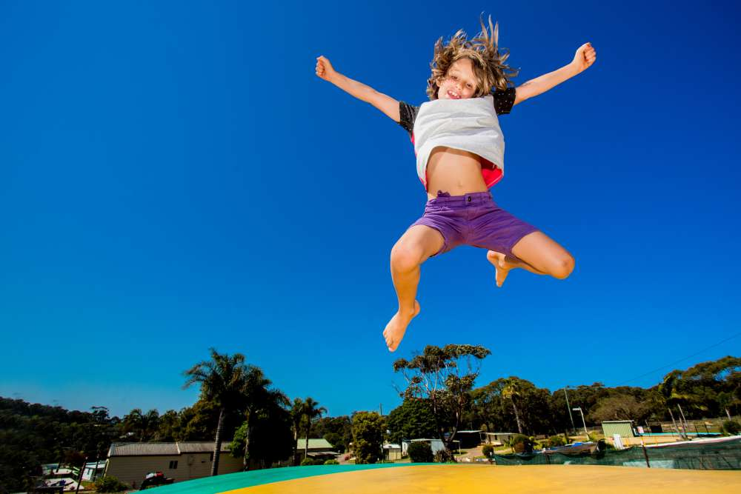
Action Photos
Notes:
Discuss:
Examples of movements that you could take a photograph of
Star jump
Twist and jump
Silly face
Running past you
Skipping
Hopping

Slide 15
Today’s challenge:
Group A:
On the roof/ small hall taking action photos
Group B:
In the DREAMS Lab taking action photos with props
Notes:
Slow motion videos:
Pompoms
Star jump
Twist jump
Jump

Slide 16
Add 4 photos and videos to Book Creator
Save Book Creator as a video
Share to Seesaw

Slide 17
Photography skills
Year 2

Slide 18
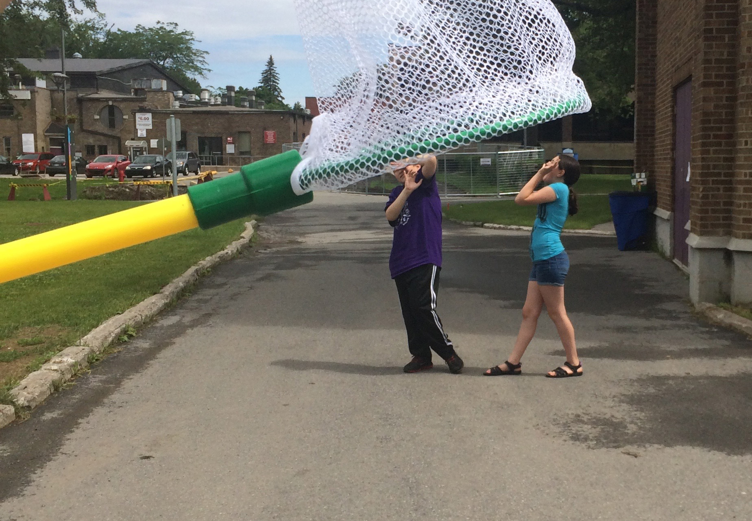
Trick Photography
How can we manipulate the perspective?

Slide 19
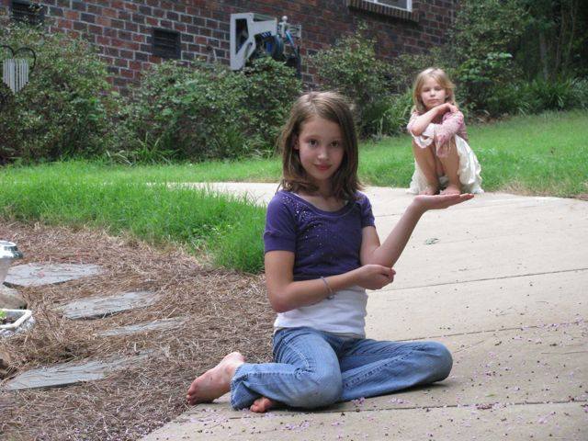
Background
Foreground

Slide 20
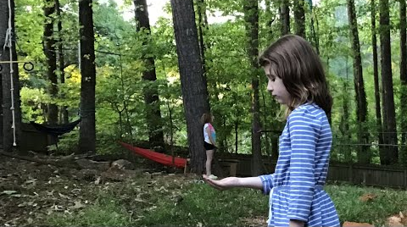
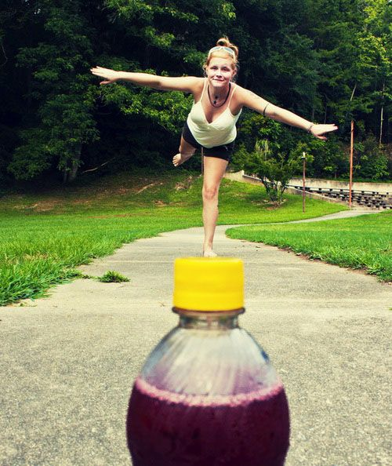
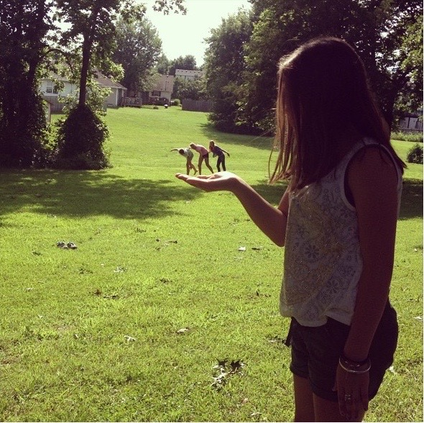
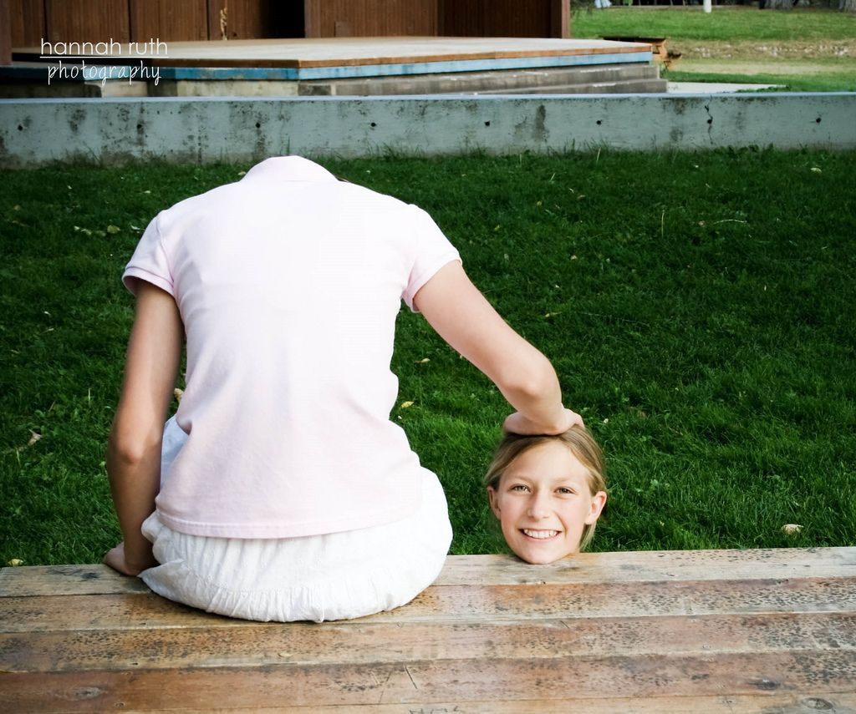
Notes:
Discuss foreground and background
What is the subject?
Where is the photographer standing?

Slide 21
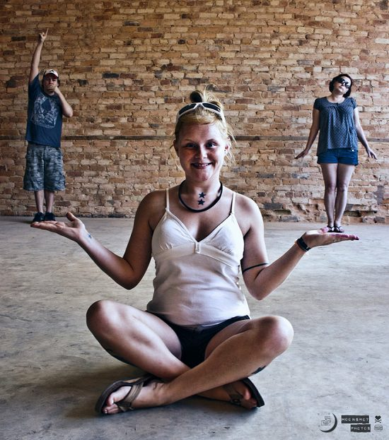
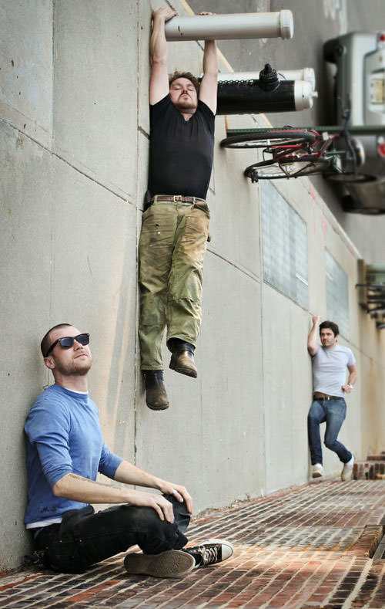

Slide 22
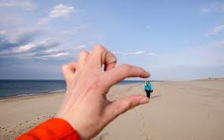


Slide 23

Today’s challenge:
Working with your friend and different objects:
Take 4 trick perspective photos
Take both portrait and landscape photos
Notes:
Go to the playground/roof
Put students in pairs. Give them an iPad and toy dinosaur.
ICT TA and class TA to monitor and support students.

Slide 24
Add 4 photos and videos to Book Creator
Save Book Creator as a video
Share to Seesaw
Comment on your friends photos
Notes:
Optional seesaw review task: https://app.seesaw.me/pages/shared_activity?prompt_id=prompt.3f5af2e5-59e5-420f-a260-6f6e8c55c963&share_token=PviX29TDTL-XcRNtmZRGCA

Slide 25

Quiz Photography knowledge
Scan the QR code
Enter your preferred name
Press the green button
Notes:
https://quizizz.com/admin/quiz/66d0267a0b144b05f94274f9?source=quiz_share

